Slide 1
Cryptocurrency exchanges
An analysis
Understanding exchange location using python
Derek hall & Charles mactutus

Slide 2
Backstory of the project
M.V.P. = a worldwide interactive scatter point map for selection of exchanges
Unlike traditional currencies, crypto exchanges are funded on different models and can even have their own coins to invest in
The goal is to visually analyze success of these models of exchanges based on location/daily volume relative to centralized vs decentralized platforms

Slide 3
Data source, cleaning & converting
Main bulk of current code
Data from https://nomics.com/exchanges into a CSV file, read with no header into Python Pandas DataFrame
Got top 100 global exchanges, cleaned down to 6 columns (name/volume/continent/country/website/DEX)
Plotly uses country in ISO3 standard for mapping, used country converter
from Pypi to convert and replace the full name country columns

Slide 4
Raw CSV Data start point

Slide 5
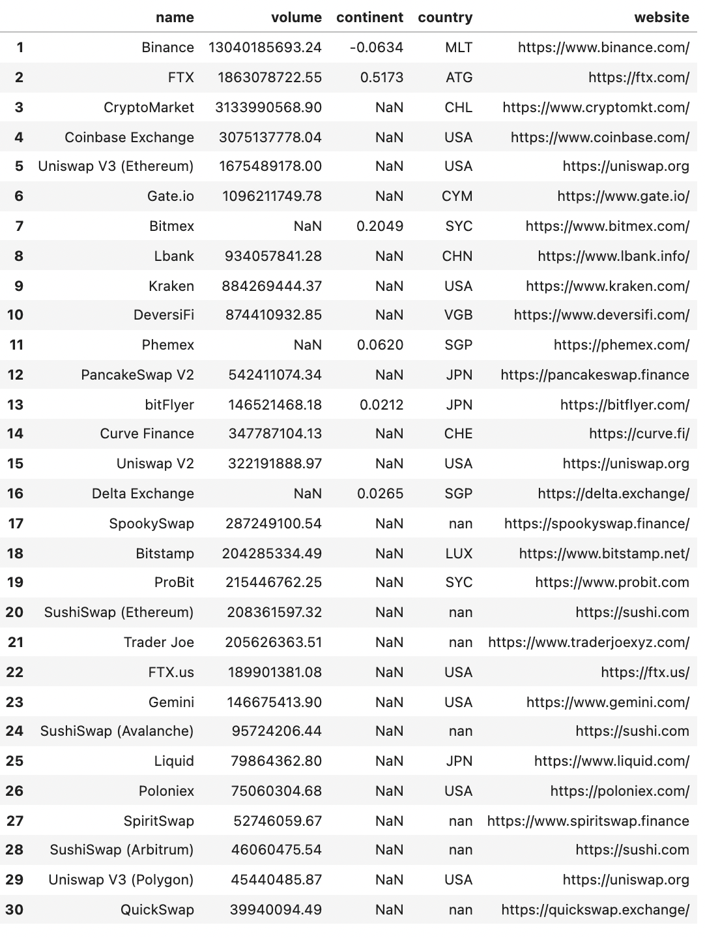
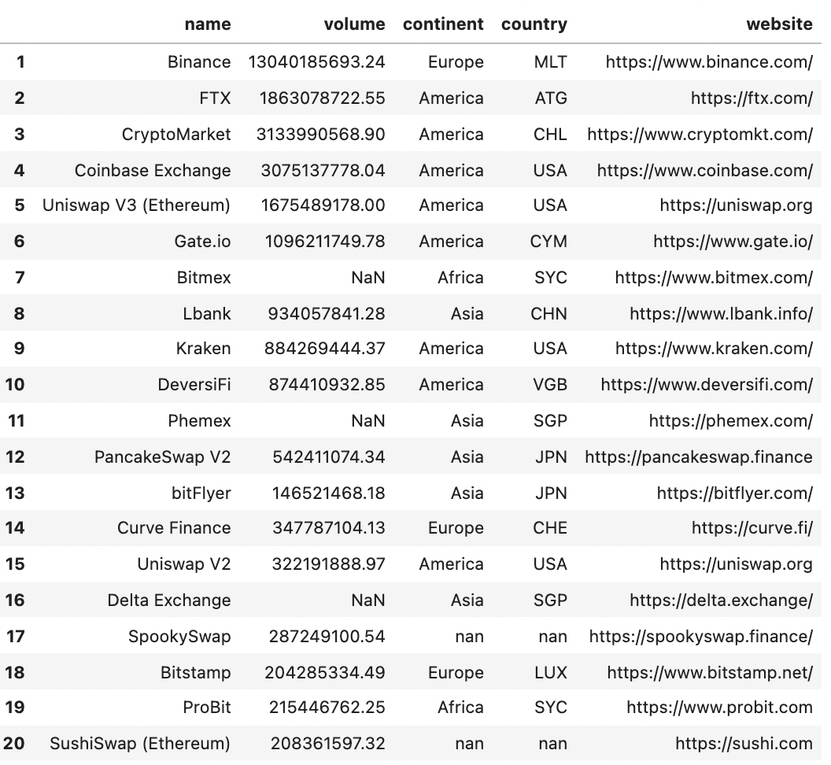
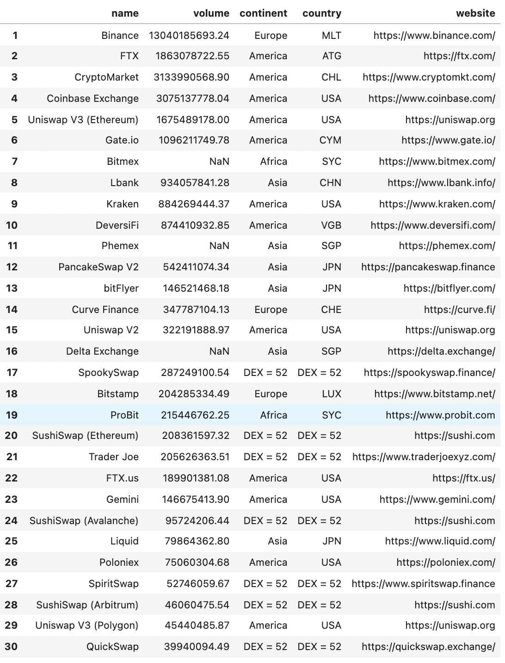
Conversion Process
1
2
3

Slide 6
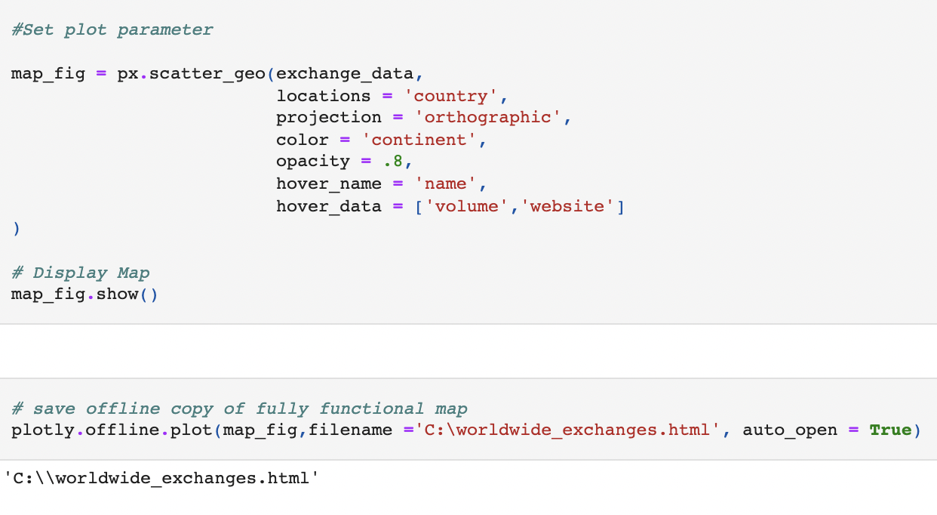
visualization
Main goal is to export an interactive map using https://plotly.com/python/

Slide 7
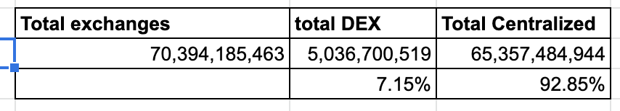
Results/Theory & code demonstration
Out of these top 100 exchanges, 52 were decentralized
Html file of the 3D map
Average Daily Volume:
Clear that most of the volume is run through centralized platforms having 8 out of the top 10
Theory: The truly decentralized platforms aren't being driven & funded like the Coinbases and the Binances (BNB). Also, maybe the majority of the population want someone they can go to for help aren’t comfortable being completely on their own.

Slide 8
Next steps
If free funding data were available, would like to see how funding models (ICO, IEO, STO) affected volume/success of both the exchange and their token
Get more creative with the visualization using logos
Use the paid API for constant data updates

